Slide 1

Process Management: An Overview
Presented By: Er. Sharat Maharjan

Slide 2

Table of Contents
.
02
.
Process States and Control
01
Introduction to Processes
.
.
03
Threads: Lightweight Processes
04
Inter-Process Communication (IPC)
.
.
05
Implementing Mutual Exclusion
06
Classical IPC Problems

Slide 3
PART 01
Introduction to Processes

Slide 4
Process vs. Program
Definition of a Program
Definition of a Process
Key Differences Explained
A program is a static set of instructions to perform a specific task; it is passive until executed. Think of it as a recipe written on paper; it's just instructions.
A process is a program in execution; it is an active entity with a program counter, stack, and data section. Therefore, a process is a program that is running.
Programs are passive entities stored on disk, while processes are active entities consuming system resources. Thus, understanding this distinction is critical for managing system performance.

Slide 5
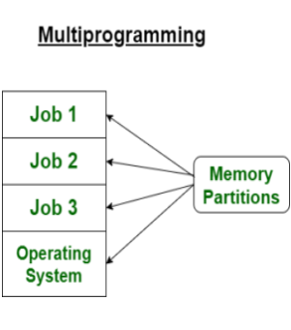
Multiprogramming Concepts
What is Multi-programming?
Benefits of Multi-programming
Multi-programming is a technique that allows multiple programs to reside in memory at the same time; this increases CPU utilization. It enables the OS to quickly switch between processes.
Increased CPU utilization; reduces idle time by overlapping I/O and CPU activities. Therefore, systems become more efficient ensuring resources are never wasted.

Slide 6
Process Model Overview
Components of a Process
Each process has code, data, stack, and heap segments; the operating system manages these segments. Each has unique role and purpose necessary for execution.
Address space layout showing code, data, stack, and heap; this provides insights into memory usage. Therefore, it's key to understand process memory organization.
Memory Organization
1
2
3
2
The Process Abstraction
Processes are viewed as independent entities with their own address space; this simplifies programming. Isolation improves system stability reducing conflicts.

Slide 7
PART 02
Process States and Control

Slide 8
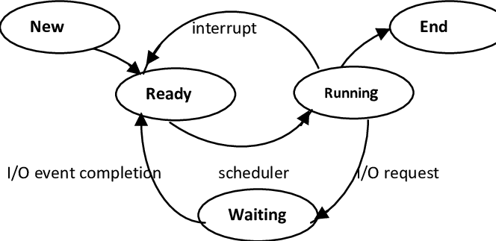
Process States Explained
01
New State
The process is being created. Operating system allocates resources to it. It's the phase before getting ready to run.
02
Ready State
The process is waiting to be assigned to a processor. It's prepared and ready to run.
03
Running State
Instructions are being executed. CPU actually carries out its instructions. This is the most active state.
04
Waiting State
The process is waiting for an event (I/O completion or signal). It's temporarily paused.
05
Terminated State
The process has finished execution. System frees up resources. It no longer exists as a process.

Slide 9
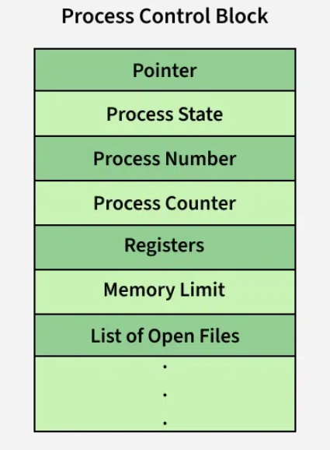
Process Control Block (PCB)
What is a PCB?
The PCB contains process-specific information: process state, program counter, registers, memory limits, etc. OS uses it to manage and schedule processes.
PCB Structure
Role of the OS
The OS creates, manages, and deletes PCBs. Thus, PCB's help the operating system perform these functions efficiently.

Slide 10
PART 03
Threads: Lightweight Processes

Slide 11
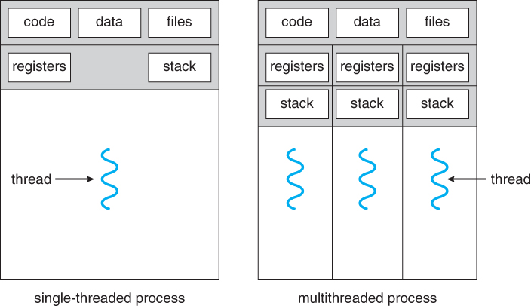
Threads Overview
Definition of a Thread
Threads are lightweight processes; they share the same address space, code, data, and OS resources. Therefore, this enables efficient communication and resource utilization.
Benefits of Threads
Improve application responsiveness, resource sharing, and economy; threads improve multitasking capabilities in the OS. Therefore, it's important to understand their benefits to achieve optimal design.

Slide 12
Thread vs. Process
Key Differences
Processes have separate address spaces, while threads share the same address space; threads are lighter and faster to create. Knowing differences helps choose the right approach for concurrency.
Resource Consumption
Threads require fewer resources than processes because they share memory; process creation requires duplicating resources. Hence, it's vital to compare based on needs.
Context Switching
Context switching between threads is faster than between processes because less state needs to be saved and restored. The speed of Thread Context switching is a major advantage.

Slide 13
User and Kernel-Space Threads
User-Level Threads
Kernel-Level Threads
Comparison
Managed by a thread library in user space; the kernel is unaware of these threads. Benefit from not needing Kernel privileges.
Managed directly by the OS kernel; the OS schedules these threads. They use OS resources requiring kernel intervention.
User-level threads are faster but can block the entire process, kernel-level threads are slower but do not block the entire process. Balancing needs is important.

Slide 14
PART 04
Inter-Process Communication (IPC)

Slide 15
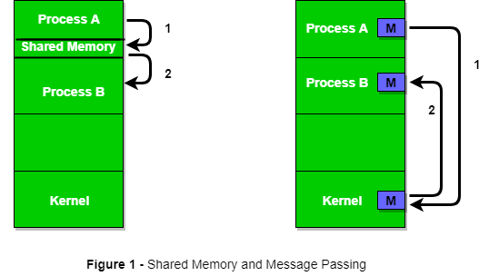
IPC Introduction
What is IPC?
IPC is a mechanism that allows processes to communicate and synchronize their actions. Processes may run on the same system or different systems connected via a network.

Slide 16
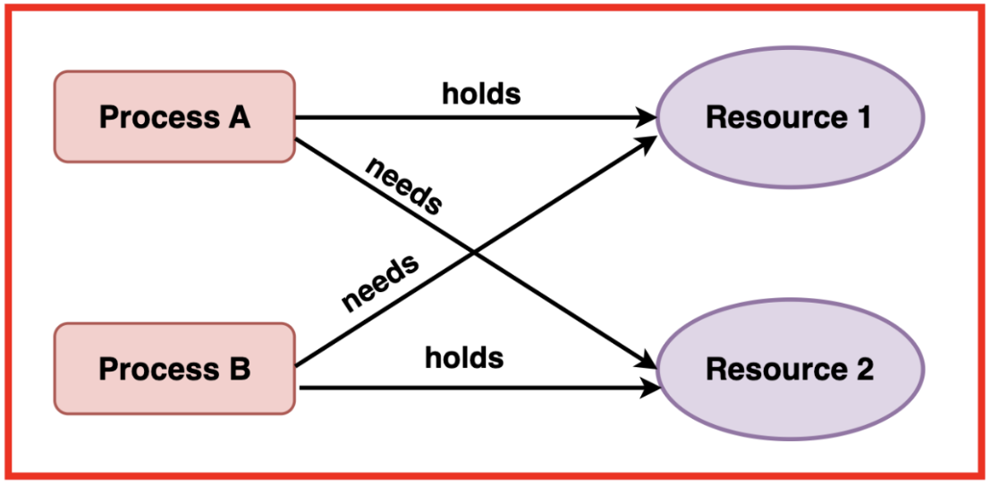
Race Condition
Definition of Race Condition
A race condition occurs when multiple processes access shared data concurrently and the outcome depends on the particular order of execution. Hence, it often causes data corruption and erratic behavior.
Example Scenario
Two processes incrementing a shared counter; the final result is incorrect if the operations are not synchronized.

Slide 17
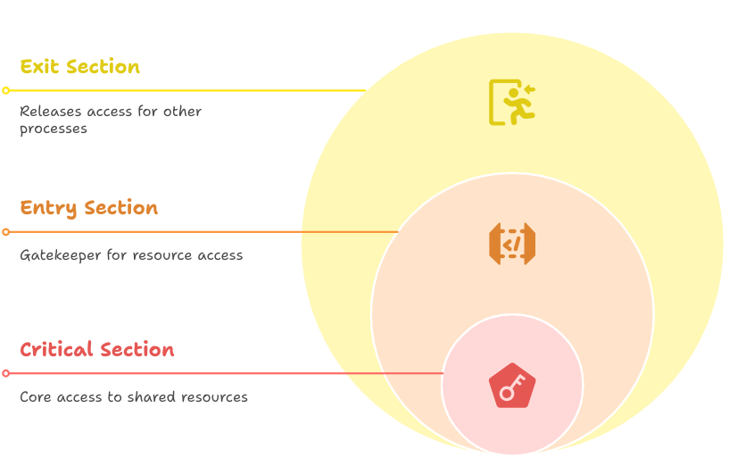
Critical Section
Definition
A critical section is a code segment that accesses shared resources; mutual exclusion is required to avoid race conditions. Defining clearly helps in applying controls.
Requirements for a Correct Solution to the Critical Section Problem
Mutual exclusion, progress, and bounded waiting are essential to avoid race conditions. Therefore, following these helps in reducing race conditions.

Slide 18
PART 05
Implementing Mutual Exclusion

Slide 19





Mutual Exclusion with Busy Waiting
- Mutual Exclusion ensures that only one process/thread accesses the critical section (shared resources) at a time, preventing race conditions.
- Busy waiting (or spinlock) means a process continuously checks for a condition (e.g., a lock) in a loop while waiting to enter the critical section.
Disabling Interrupts
Lock Variables
Strict Alteration
One process disables interrupts before entering the critical section and enables them after exiting; only works on single-processor systems. This helps ensure exclusive access.
A shared variable (lock) is used to indicate whether a process is in the critical section; simple but prone to errors. Therefore, careful implementation is a must to work effectively.
Processes take turns entering the critical section; inefficient if one process is much slower. Efficiency considerations limit its broad applicability.
Peterson's Solution
Test and Set Lock
A software-based solution that ensures mutual exclusion; involves shared variables and flags. Better than simple lock variables.
A hardware-based solution using an atomic instruction to test and set a lock; avoids busy waiting. Its use of hardware support makes it more reliable.

Slide 20
Sleep and Wakeup
Sleep Primitive
A process blocks itself, relinquishing the CPU; the OS puts the process in the waiting state. It frees up CPU and improves overall efficiency.
Wakeup Primitive
Another process wakes up the sleeping process, making it ready to run; requires careful synchronization to avoid lost wakeups. Therefore, careful synchronization is a must.

Slide 21
Semaphores
What is a Semaphore?
Binary vs. Counting Semaphores
A semaphore is an integer variable accessed only through atomic operations: wait (P) and signal (V); used for process synchronization. A fundamental technique for process synchronization.
Binary semaphores can have values 0 or 1; counting semaphores can have non-negative integer values. Therefore, knowing both helps apply where best fits.

Slide 22
Monitors
Monitor Concept
A high-level synchronization construct where shared dataand procedures are grouped together. Only one process can execute a monitor procedure at a time.
Condition Variables
Used within monitors to allow processes to wait for a specific condition to become true; signal and wait operations. It's a practical implementation to improve software quality.

Slide 23
Message Passing
Message Passing Overview
Processes communicate by sending and receiving messages; can be synchronous or asynchronous. Fundamental paradigm for distributed systems.
Advantages
Suitable for distributed systems where shared memory is not available; provides flexibility and scalability. Key technique for distributed systems.

Slide 24
PART 06
Classical IPC Problems

Slide 25
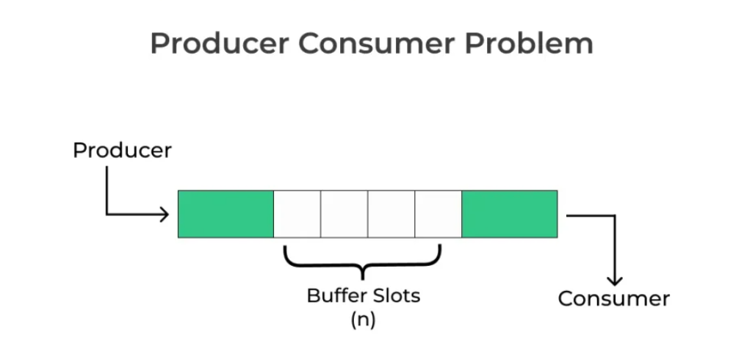
Producer-Consumer Problem (Bounded Buffer Problem)
Problem Description
A producer process produces data and a consumer process consumes data; both access a shared buffer; synchronization is required. It's a core synchronization challenge.
Solution Using Semaphores
Use semaphores to control access to the buffer; ensure bounded buffer capacity. Using semaphores ensures a smooth workflow.

Slide 26
Sleeping Barber Problem
Problem Description
- A barber sleeps when there are no customers.
If a customer arrives:
- Wakes the barber if sleeping.
- If all chairs are full, customer leaves.
- Else waits in the waiting room (limited chairs).
Real-life Analogy:
- A barbershop with one barber and N waiting chairs.
Solution
Use semaphores to manage customers waiting and the barber's availability ensuring no customer is missed. Key solution for managing states.

Slide 27
Dining Philosophers Problem
Problem Description
- 5 philosophers sit around a table.
- Each needs two forks to eat (left and right).
- A fork is shared between neighbors.
Goal: avoid deadlock and starvation.
Real-life Analogy:
- Philosophers alternate between thinking and eating.
- There are only 5 forks (1 between each pair).
Problem Issues:
- If all philosophers pick the left fork first, they deadlock.
- Some philosophers may starve if others keep eating.
Solution
Use a semaphore to control access to the forks; prevent deadlock byordering the philosophers. Practical approach to prevent deadlock situations.

Slide 28
PART 07
Process Scheduling

Slide 29
Scheduling Goals
Minimize the time processes spend waiting in the ready queue. It should be the least amount of time possible.
Minimize the time between process submission and completion; includes waiting time and execution time reducing unnecessary waits. Minimizing waits ensures tasks completed efficiently.
Maximize the number of processes completed per unit time ensuring tasks completed efficiently. Maximizing throughput allows for more completed tasks.
Maximize CPU usage; keep the CPU as busy as possible; important for efficient operation. Improving CPU usage helps with efficiency.
01
02
03
04
CPU Utilization
Throughput
Turnaround Time
Waiting Time

Slide 30
Batch System Scheduling
Shortest Job First (SJF)
Processes with the shortest execution time are scheduled first; minimizes average waiting time; requires knowing execution time in advance. This helps you get the best execution results.
Keywords
First-Come, First-Served (FCFS)
Shortest Remaining Time Next (SRTN)
Processes are scheduled in the order they arrive; simple, but can result in long waiting times. It suffers from convoy effect.
Preemptive version of SJF; the process with the shortest remaining time is scheduled. It's more complex but more optimized.

Slide 31
Interactive System Scheduling
1
2
3
Round-Robin Scheduling
Priority Scheduling
Multiple Queues
Each process gets a fixed time slice; if not completed, it goes to the back of the ready queue; fair and responsive. Helps ensure fairness across all users.
Processes are assigned priorities; higher priority processes are scheduled first; can lead to starvation of low-priority processes. Dynamic adjustments often needed.
Multiple ready queues with different priorities; processes are assigned to queues based on their characteristics improving fairness and throughput. Can offer the best compromise.

Slide 32

Real-Time System Scheduling
Types of Real-Time Systems
Hard real-time systems must meet deadlines; soft real-time systems can tolerate occasional missed deadlines. Important distinction for designers.
Real-Time Overview
Meets strict timing constraints; used in critical applications; timing is crucial. Real-time is the most restrictive.

Slide 33
PART 08
Conclusion

Slide 34

Summary of Key Concepts
Recap
Processes, threads, IPC, and scheduling are fundamental concepts in process management. Therefore, it is essential to understand the material.

Slide 35



Importance of Process Management
Efficient Resource Utilization
Proper process management is crucial for efficient use of system resources. In other words, it helps the system to run smoother.

Slide 36
Future Trends
Advancements in OS
Advancements in operating systems continue to improve process management techniques. This helps solve real-world challenges.

Slide 37
Thank you for listening.
Author: Author's Name

